Slide 1
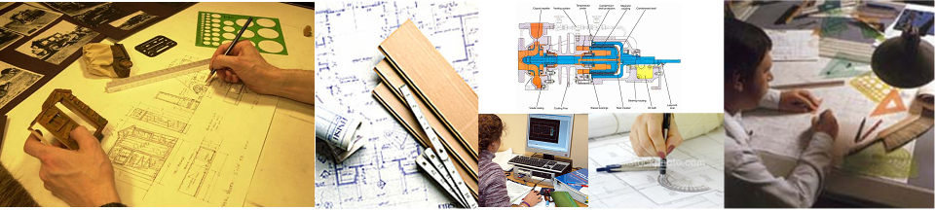
Chapter 3
Orthographic Projection

Slide 2
TOPICS
Object representation
Multiview projection
Glass box concept
Orthographic projection of point,
line, plane, surface and object.
Line convention

Slide 3
OBJECT REPRESENTATION
Axonometric projection
Multiview projection

Slide 4
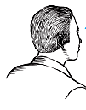
MULTIVIEW PROJECTION
Three principle dimensions
of an object …
… can be presented only
two in each view.
Adjacent view(s)
is needed to
fulfill the size
description.
Height
Depth
Width
Depth
Height
Width
Depth

Slide 5
TO OBTAIN MULTIVIEW REPRESENTATION OF AN OBJECT
Revolve the object with respect
to observer.
The observer move around the
object.

Slide 6
REVOLVE THE OBJECT
Top view
Front view
Right side view

Slide 7

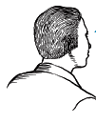
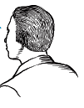
OBSERVER MOVE AROUND
Top view
Front view
Right side view

Slide 8
THE GLASS BOX CONCEPT
Rear view
Left side view
Bottom view

Slide 9
History
Depth
Width
Height

Slide 10
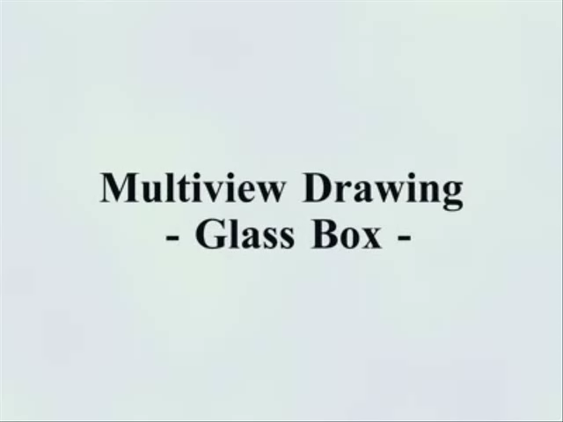
MULTIVIEW PROJECTION
Click on the picture to play video

Slide 11
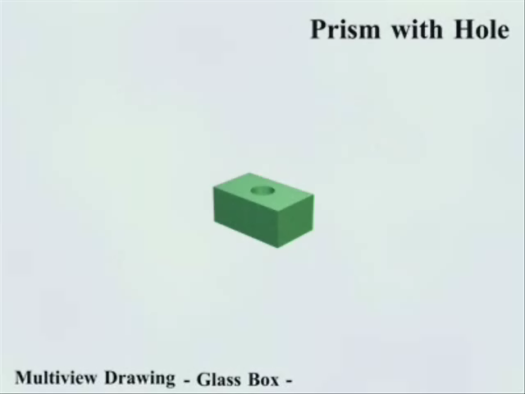
MULTIVIEW PROJECTION
Click on the picture to play video

Slide 12
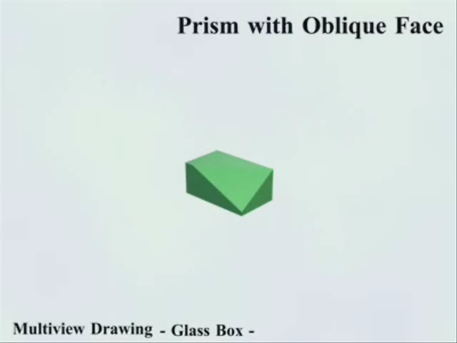
MULTIVIEW PROJECTION
Click on the picture to play video

Slide 13
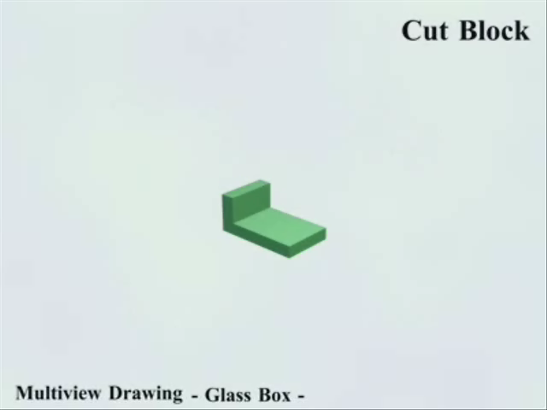
MULTIVIEW PROJECTION
Click on the picture to play video

Slide 14


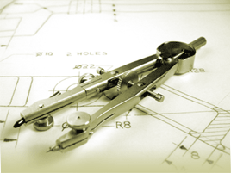
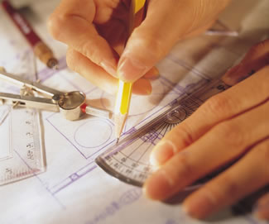
Orthographic Projection
of Object Features

Slide 15
OBJECT FEATURES
Edges
are lines that represent the boundary
between two faces.
Corners
Represent the intersection of two or
more edges.
Edge
Edge
No edge
Corner
No corner
No corner

Slide 16
OBJECT FEATURES
Surfaces
are areas that are bounded by edges
or limiting element.
Limitingelement
is a line that represents the last visible
part of the curve surface.
Surface
Surface
Surface
Limit
Limit

Slide 17
PROJECTION OF POINT(S)
B_{T}
B_{T}
A_{T}
Equal
distance
A_{T}
B
A
B_{R}
A_{F}
B_{F}
A_{F}
B_{F}
A_{R}
B_{R}
A_{R}

Slide 18
PROJECTION OF LINE
True length
B_{T}
A_{T}
B_{T}
Equal
length
A_{T}
B
A
B_{R}
A_{F}
B_{F}
A_{F}
B_{F}
A_{R}
B_{R}
A_{R}
Point
True length
NORMAL LINE

Slide 19
PROJECTION OF LINE
True length
B_{T}
A_{T}
B_{T}
Equal
length
A_{T}
B
A
A_{F}
A
B_{R}
B_{F}
A_{F}
B_{F}
A_{R}
B_{R}
A_{R}
Foreshortened
Foreshortened
INCLINED LINE

Slide 20
PROJECTION OF LINE
Foreshortened
B_{T}
A_{T}
B
B_{T}
Equal
length
B_{F}
B_{R}
A_{T}
B
A
B_{F}
B_{R}
A_{F}
A
A_{F}
A_{R}
A_{R}
Foreshortened
Foreshortened
OBLIQUED LINE

Slide 21
PROJECTION OF PLANE
True size
C_{T}
B_{T}
C_{T}
A_{T}
Equal
length
B_{T}
A_{T}
C
B
B_{F}
A
C_{R}
A_{F},C_{F}
B_{F}
A_{F},C_{F}
A_{R},B_{R}
C_{R}
A_{R},B_{R}
Edge
Edge
NORMAL PLANE

Slide 22
PROJECTION OF PLANE
Foreshortened
C_{T}
B_{T}
C_{T}
A_{T}
C
Equal
length
C_{R}
B_{T}
A_{T}
C_{F}
C
B
C_{F}
C_{R}
B_{F}
A
A_{F}
A_{R},B_{R}
B_{F}
A_{F}
A_{R},B_{R}
Foreshortened
Edge
INCLINED PLANE

Slide 23
PROJECTION OF PLANE
Foreshortened
C_{T}
B_{T}
C_{T}
A_{T}
C
Equal
length
B
C_{R}
B_{T}
B_{F}
C_{F}
A_{T}
C
B
C_{F}
B_{R}
B_{R}
C_{R}
B_{F}
A
A_{F}
A_{R}
A_{F}
A_{R}
Foreshortened
Foreshortened
OBLIQUED PLANE

Slide 24
PROJECTION OF OBJECT
The views are obtained by projecting all object features to the picture plane.
You have to project the remaining surfaces which are
invisible too !

Slide 25
PROJECTION OF OBJECT
s
s
s

Slide 26
PROJECTION OF OBJECT

Slide 27
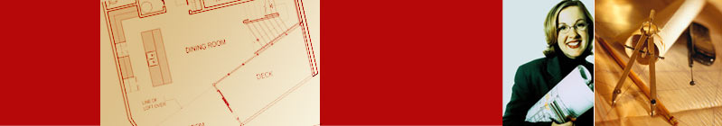

Line Convention

Slide 28
LINE CONVENTION
Precedence of coincide lines.
Hidden line drawing.
Center line drawing.

Slide 29
PRECEDENCE OF LINE
Order of
importance
Visible
line
Hidden
line
Center
line

Slide 30
HIDDEN LINE PRACTICE
Hidden line should join a visible line, except it
extended from the visible line.
Leave
space
Correct
Join
No !

Slide 31
HIDDEN LINE PRACTICE
Hidden line should join a visible line, except it
extended from the visible line.
Leave
space
Leave
space
Correct
No !

Slide 32
HIDDEN LINE PRACTICE
Hidden line should intersect to form L and T
corners.
L
T
Correct
No !

Slide 33
HIDDEN LINE PRACTICE
Hidden arcs should start on a center line.

Slide 34
CENTER LINE PRACTICE
In circular view, short dash should cross at the intersections of center line.
For small hole, center line is presented as thin continuous line.
Center line should not extend between views.
Leave space
Leave space

Slide 35
CENTER LINE PRACTICE
Leave the gap when centerline forms a continuation with a visible or hidden line
Center line should always start and end with
long dash.
Leave
space
Leave
space
Leave
space
Leave
space

